Slide 1


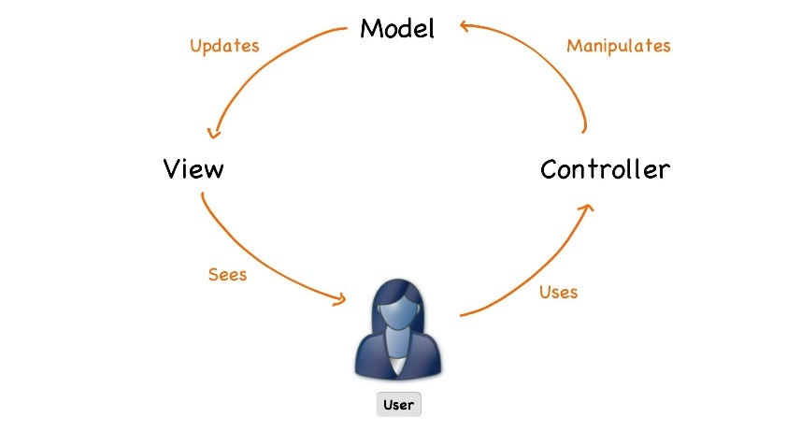




Java Web Development Basics
Course Introduction
Java Web Dev Basics
SoftUni Team
Technical Trainers
Software University
http://softuni.bg

Slide 2




Table of Contents

Slide 3








SoftUni Diamond Partners

Slide 4
Questions
sli.do #java-web

Slide 5

Java Web Module @ SoftUni
4 Months Web Development Training

Slide 6
Java Web Module Goals
“Java Web" Module @ SoftUni
4 times weekly, mainly practical exercises
Part I – Web Development Basics
Web Fundamentals, HTTP Protocol, Hand-Made Web Server, Hand-Made MVC Framework
Part II – MVC Frameworks
Essentials, View Engines, Security, Architecture, Unit Testing, Services, Control Flow, Deployment

Slide 7
Java Web Module at SoftUni – Timeline
15-Jan-2017
26-Feb-2017
May-2018
Java Web Development Basics
Lessons + exercises + exam
6 weeks * 4 times / week
12 credits
Start: 15-January-2018
Exam: 25-February-2018
Java MVC Frameworks
Lessons + exercises + exam
8 weeks * 4 times / week
18 credits
Start: 26-February-2018
Project Defense: 22-April-2018
Java Web Re-Take Exams
First week of May 2018

Slide 8

Java Web Development Basics
Course Objectives & Program

Slide 9


Java Web Dev Basics – Course Program
Course Introduction – Course Program, Trainers, Exams, Resources
Web Fundamentals Introduction: HTML & CSS
Web Server & CGI: What is a Web Server? What is CGI?
HTTP Protocol – HTTP Protocol Intro, Requests, Responses
State Management – Cookies & Sessions
Workshop: Web + Hibernate – Including Hibernate
Web Server – Creating a Simple Web Server from Scratch

Slide 10



Programming Fundamentals – Course Program (2)
Introduction to Servlet API – Apache Tomcat, Servlets, JSP
Introduction to MVC – Creating a Simple MVC Framework
Workshop: MVC – Implementing a web application with the MVC Framework
Exam Preparation

Slide 11

The Trainers Team

Slide 12

Trainers Team
Ivaylo Jelev
Training Leader @ Software University
Almost 2 years of being Technical Trainer @ Software University
Top Performing Student
Professional Exercise & Exam Problem Creator ☺

Slide 13
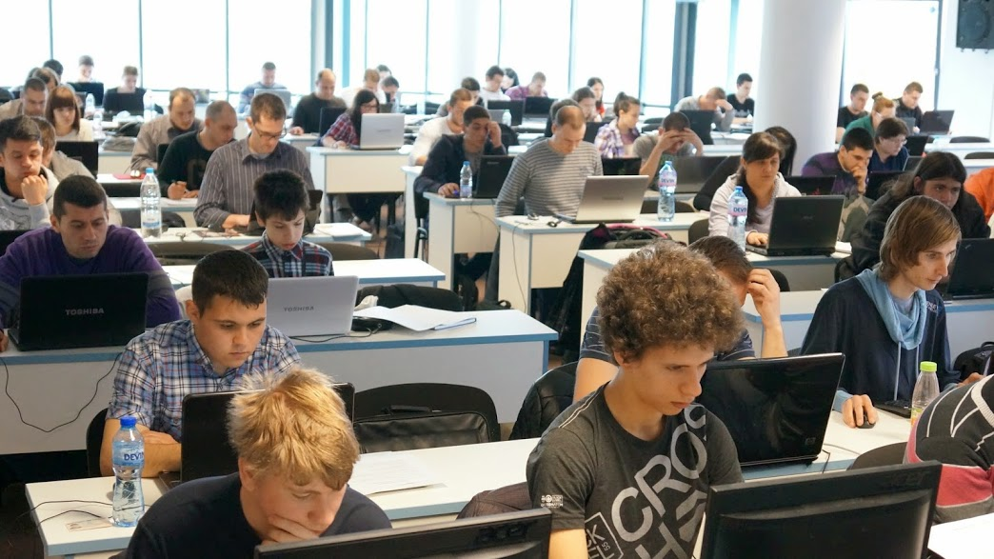
Java Web Dev Basics: More Details
Duration, Schedule, Languages, etc.

Slide 14


Training Duration – Java Web Dev Basics
Lessons: ~50 hours (onsite + videos)
Practical exercises (in class): ~60 hours
Exam preparation: 2*4 hours
Exam: 6 hours
Schedule: January – February 2018
Exam date: 25 February 2018

Slide 15



Why English?
Why the slides are in English?
English is the native language of the software engineers
Specific terminology should be in English
Translations are inaccurate and funny
Just learn English!
No excuses

Slide 16



Learn to Search in Internet & Find Solutions!
The course assignments require to search in Internet
This is an important part of the learning process
Some exercises intentionally have no hints
Learn to find solutions!
Software development includes everyday searching and learning
No excuses, just learn to study!
Developers learn new technologies, tools, languages every day!

Slide 17

Evaluation

Slide 18
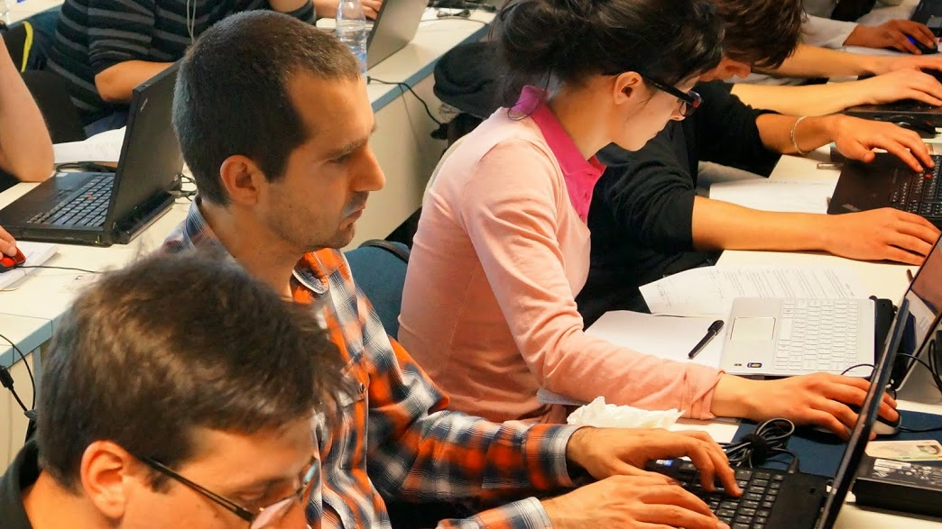
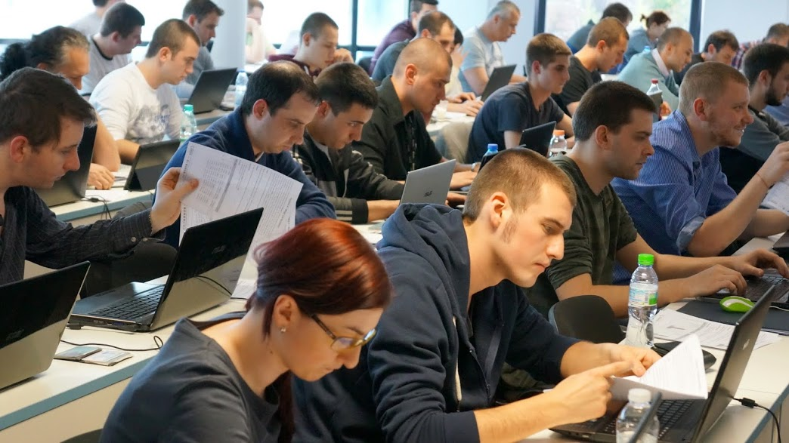

Java Web Dev Basics
Evaluation Criteria

Slide 19


Scoring System for “Java Web Dev Basics”
Exam – 90%
Homework (exercises) – 10%
Bonuses: up to 10%
Presence in class: 5% (onsite students only)
Forum activities
Others

Slide 20
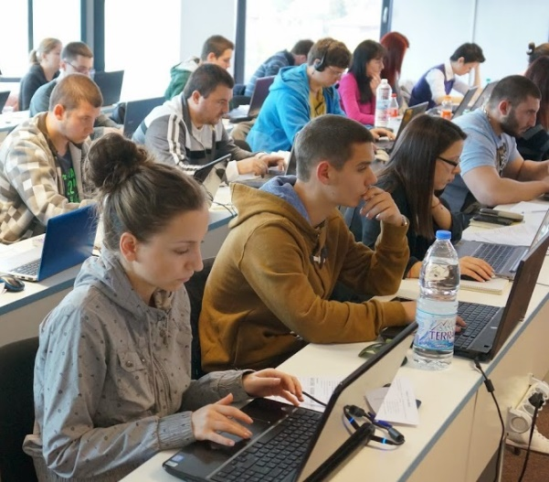

Java Web Development Basics Exam
Practical web development exam
Implementing a simple web application
Given the MVC Framework and Web Server
Given a portion of the Views in a raw form
Duration: 6 hours.
Solutions are evaluated by hand after the exam

Slide 21

Homework Assignments
Doing your homework is very important!
Programming can only be learned through a lot of practice!
You should write code every day!
Each lesson is followed by many exercises
Try to solve them in class
The rest are your homework
Homework assignments are due in 6 days after each lecture
Submission are sent on the course page at softuni.bg

Slide 22










Resources
What We Need Additionally?

Slide 23


Your RFID Chip
Students can either
Take RFID chip from SoftUni
Or use their own chip / card
Register your chip number in your SoftUni profile: https://softuni.bg/users/profile/show
Check-in at the reception every time when you come
See your last visits in your profile: https://softuni.bg/users/profile/show

Slide 24



Java Web Dev Basics Site, Forum and FB Group
Official web site:
Official discussion forum:
Official Facebook groups:
https://softuni.bg/courses/java-web-development-basics
https://softuni.bg/forum/categories/73/Java-Web-Development-Basics
https://www.facebook.com/groups/java.web.module.jan.2018/

Slide 25

The Java Web Slides and Videos
All lecture slides, videos, homework assignments, projects and other resources are open content, available for free
Visit the course web site to access the course resources

Slide 26

Software University Learning System (SULS)
Software University Learning System (SULS)
www.softuni.bg
Important resource for students
Homework submissions
Homework check-up
Exams and results
Reports about your progress
…

Slide 27


Required Software
Software needed for this course:
Microsoft Windows (Win 10 / 8.1 / Win8 / Win7) or Mac or Linux
JetBrains IntelliJ Idea
Eclipse

Slide 28




Summary
Training program
Practical exam
Simple Web Application for 6 hours
Learning resources
Slides, videos, software, books, forum

Slide 29
Java Web Dev Basics – Course Overview
https://softuni.bg/courses/java-web-development-basics

Slide 30
License
This course (slides, examples, demos, videos, homework, etc.) is licensed under the "Creative Commons Attribution-NonCommercial-ShareAlike 4.0 International" license

Slide 31





Trainings @ Software University (SoftUni)
Software University – High-Quality Education, Profession and Job for Software Developers
softuni.bg
Software University Foundation
http://softuni.foundation/
Software University @ Facebook
facebook.com/SoftwareUniversity
Software University Forums
forum.softuni.bg

